Slide 1
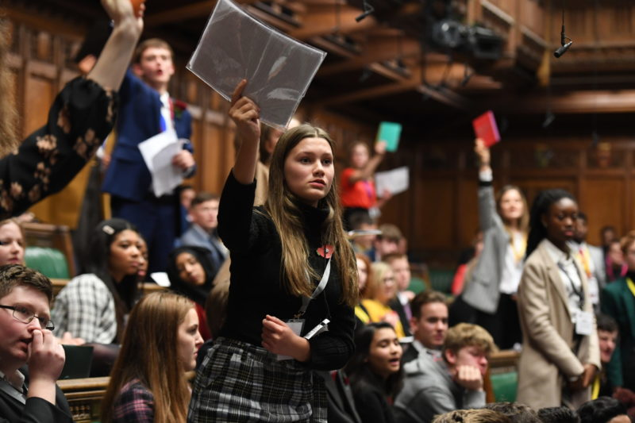
UK Youth Parliament Elections 2024
Presenter(s) name
Presenter(s) job title

Slide 2
What is UKYP?
UKYP was launched in 1999 and held its first sitting in the House of Commons in 2001.
UK Youth Parliament provides opportunities for 11–18-year-olds to use their elected voice to bring about social change through meaningful representation and campaigning.
During their term of office, Members of Youth Parliament (MYPs) work with their MPs, decision-makers, councillors and local youth groups on the issues of greatest concern to their constituents.
To find out more visit – www.byc.org.uk/uk/uk-youth-parliament

Slide 3
What does Wakefield do?
Wakefield Council’s Youth Voice Team run a weekly Youth Council where members meet to discuss the issues and priorities for young people in the Wakefield district.
The Youth Voice Team run Build Our Futures Summits, and these are used to communicate with young people about the issues affecting them.
Staff support UKYP Members to attend local, regional and national events to speak about the work they are doing.

Slide 4
Why Vote?
Because you have the right to be taken seriously and to share your views and ideas.
Because it gives you a voice?
You have the right to be listened to.
Building services that work for everyone,
helping everyone to succeed

Slide 5
What is a Manifesto?
A manifesto is a public statement of intentions (promises) that a candidate feels are issues that need to change.
It’s a way of telling people what they are all about and what they will do should they be elected.
Building services that work for everyone,
helping everyone to succeed

Slide 6
How I vote
You will get only 1 vote.
You will be asked to look at the manifestos and make your decision on who you would like to become a member of UKYP. Please remember their identifying letter code, A,B,C,D or E.
There’s 2 ways to vote:-
a) Each person is issued with a voting paper so that you can submit your own secret vote.
b) The group can decide to raise hands and these will be counted and added to the Tally Sheet. (You can still request your own voting paper if you want your vote to remain a secret).

Slide 7
Candidate “A”
I’m on a mission to represent YOU in Youth Parliament. Our identities matter, and so does our safety. I’ll ensure that your unique voices are heard, respected, and celebrated. Together, we will create safe spaces for all young people.
🤝 Identity Matters: I’ll champion inclusivity, making sure our schools and communities respect everyone, regardless of who they are. Your identity, whether it’s race, gender, or background, should be a source of strength, not a barrier. Everyone deserves to be respected.
🛡️ Safety First: I’ll work to enhance safety measures in schools and public spaces. Cybersecurity matters too! We’ll collaborate on initiatives to make online spaces safer for all. Let’s prioritise mental health resources, ensuring that support is accessible whenever you need it.
🤲 Support for Young Carers: Young carers, your efforts are noticed. I’ll advocate for more financial and emotional support to ease your responsibilities. Work alongside schools to ensure the right support is in place for you guys. No one should carry the load alone.
Vote for me in Youth Parliament - because your future matters, your safety matters, and your voice matters. Together, let’s make a lasting impact.
Building services that work for everyone,
helping everyone to succeed

Slide 8
Candidate “B”
As a candidate for the UK Youth Parliament, MYP position, I aim to represent the young people of Wakefield who make up over 20% of our community.
I recognise the need for better communication therefore I aim to actively engage with you, ensuring your concerns are heard and involving you in decisions that concern you by introducing informal drop-in hours.
Transportation has always been a critical issue for the young people of Wakefield - many of you face challenges getting home at night. If elected I will lead efforts to make transport more accessible and affordable addressing a fundamental need for you.
I aim to combat issues like child poverty and youth crime in Wakefield. My plan involves creating a website and social media platform for affordable training and job opportunities, alongside advocating for increased government investment in youth projects, reducing crime, and fostering a supportive environment for your growth.
I will support the formation of student-led anti-bullying groups in schools to monitor and address bullying during breaks, lunchtimes, and beyond, supporting teachers and promoting diversity, equality, and awareness for disabled and SEN students establishing a secure and welcoming environment within our schools.
Building services that work for everyone,
helping everyone to succeed

Slide 9
Candidate “C”
I want to stand as a Member of Youth Parliament because I would like to give young people in the Wakefield district a voice, and I have outlined a promise for if I am elected.
Safer Buses
Have you ever felt unsafe on buses? I certainly have, and if I am elected, I will attempt to talk to groups like the West Yorkshire Bus Alliance to implement a system for young people to be safer on buses.
How?
So how will this happen? Well, I propose a new priority card system on buses, like that of a U19 bus pass, allowing school children to get on the bus first, particularly at peak times like after school.
Building services that work for everyone,
helping everyone to succeed

Slide 10
Candidate “D”
Through my voice, I will represent you.
Bullying is a huge problem even leading into hate crimes; more predominantly through social media/school.
In 2019, around 22% of students aged 12-18 reported being bullied. However, one school community has set up kindness charters/kindness ambassadors. These ambassador roles, if correctly enforced, could reduce bullying. Responsible pupils elected in these positions educate peers around unacceptable behaviour. Enforcing this, I will become directly involved with headteachers influencing spreading awareness on bullying.
Also, within the district, youth groups are open for young people to attend. These are safe spaces for young people to be who they truly are, whether representing their identity within an LGBTQIA+ group, or their passion through youth council. Yet these groups are not given the right funding and worry about continuing due to unaffordability.
If a group that a child attends shuts down, this can be detrimental to a young person’s mental health, they will lose the extra support they may need. LGBTQIA+ groups in the district also educate parents/guardians on the LGBTQIA+ community, so if groups are shut down, how can this be reliably communicated. I will interact with Wakefield Council to help groups thrive. It is time to act!
Building services that work for everyone,
helping everyone to succeed

Slide 11
Candidate “E”
If elected, my foremost commitment will be to address the pressing issue of mental health within our community. This generation, profoundly impacted by recent events, has witnessed a staggering 89% surge in mental health challenges during the onset of the pandemic. To confront this matter, I propose the establishment of targeted mental health initiatives, specifically designed to aid the youth of Wakefield.
In addition to prioritising mental health, I am determined to address the escalating concerns surrounding drug use and knife crimes. Alarming statistics reveal a 157% increase in recorded knife crimes and a 150% surge in drug usage, marking the highest figures in the West Yorkshire district. It is imperative to note that these statistics likely underestimate the actual prevalence of such crimes. Moreover, reports from young individuals highlight a prevailing sense of insecurity in public spaces like parks due to these activities.
Recognising the pressing cost of living crisis for young people, exacerbated by a 6.8% inflation rate, I am committed to alleviating the financial burden on families striving to meet basic needs. My proposed strategy involves facilitating the inclusion of 16+ individuals in tailored employment schemes. Despite the existence of numerous apprenticeships, the application process poses a significant challenge for many young individuals lacking work experience. I understand the difficulties in securing an apprenticeship without prior work experience. I will actively assist them in navigating this stage, ensuring they acquire valuable work experience, earn for their families, and contribute to weathering the crisis without resorting to desperate measures or engaging in illegal activities.
Building services that work for everyone,
helping everyone to succeed

Slide 12
What Next?
Your votes will be counted and added to the rest of the votes submitted.
The candidates will be told the outcome of the vote at an event on 29 February at the Town Hall. This event will be live on Facebook on the Platform One Youth Hub page.
The candidates will be in post for 2 years.

